Slide 1
C0Ding Workshop Wk03:Yuta Nakayama

Slide 2
Quick Review:Week02
Introduction to Electronics/Arduino Programming
Digital Input / Output digitalRead(); | digitalWrite();
Analog Input / Output
analogRead(); | analogWrite();
Sensor Input
map();
Serial.begin();
Serial.print();/ Serial.println();

Slide 3
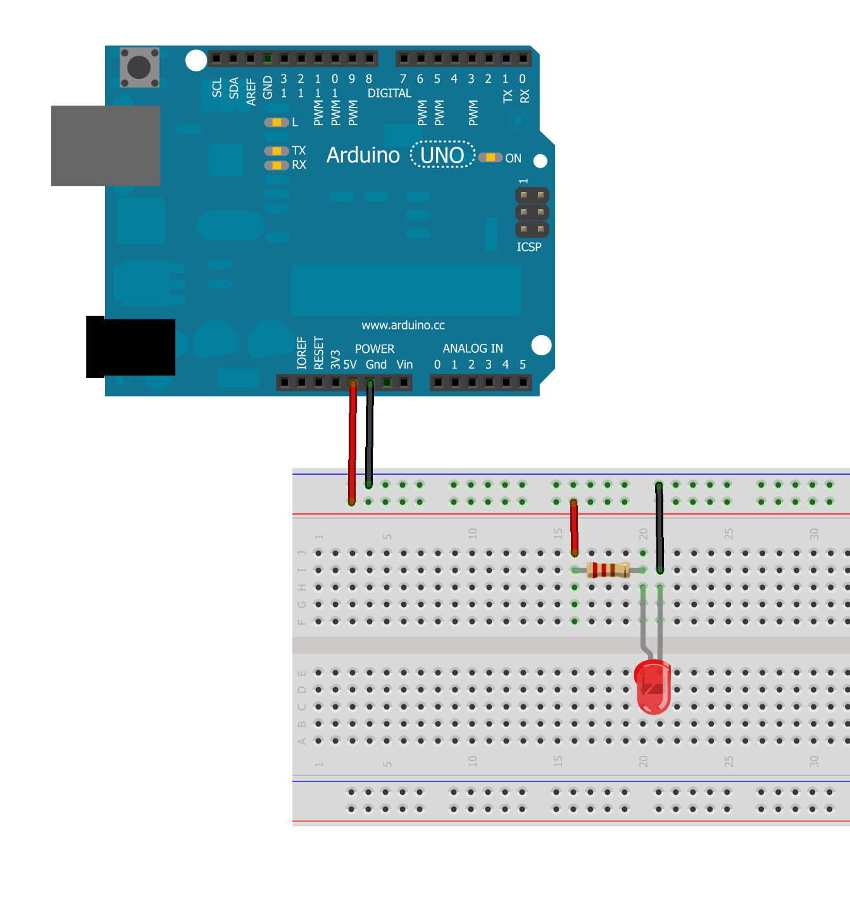
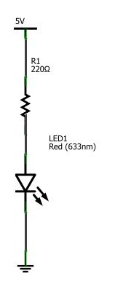
LED1:: My 1st LED Circuit
Power +5v
Resistor
LED
GND

Slide 4
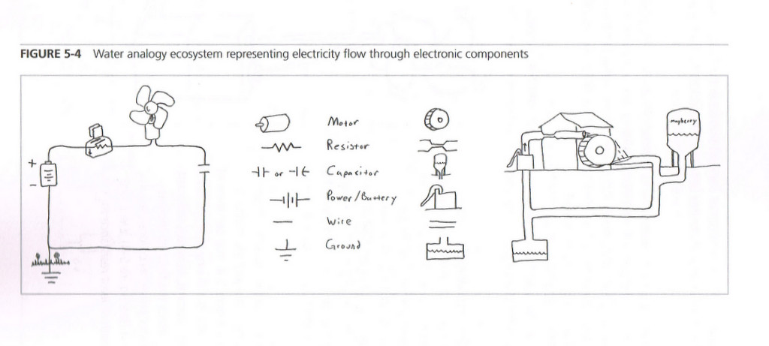
Water Analogy of Electrical Circuit
Making Things Move

Slide 5
Q1: Why do you need a resistor here?
Power +5v
Resistor
LED
GND

Slide 6
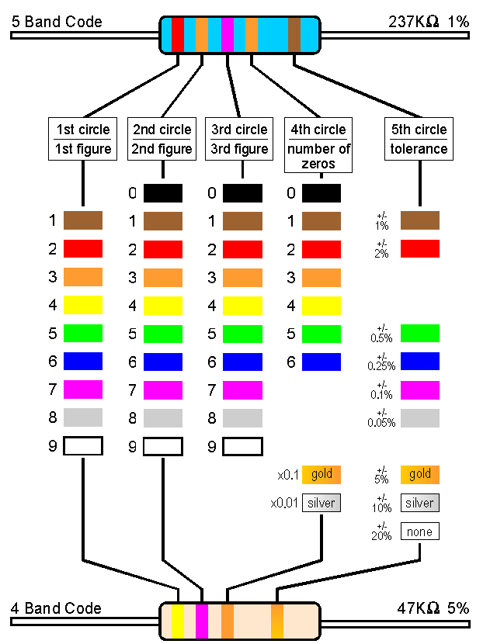
Resistor ColorCode
1 : Brown
2 : Red
3 : Orange
4 : Yellow
5 : Green
6 : Blue
7 : Purple
8 : Gray
9 : White
0 : Black
Tolerance
+/- 5% : Gold
+/- 10% : Silver

Slide 7
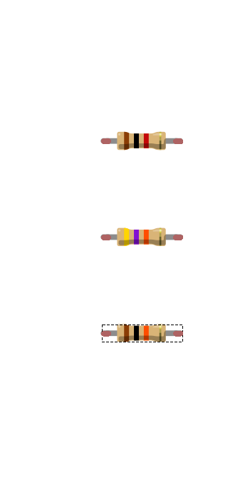
Reading Resistor Color Code
Brown Black Red Gold
1 0 x 100 ^{+/- 5%} = 1000 = 1k Ohm
Yellow Purple Orange Gold
4 7 x 1000 ^{+/- 5%} = 47000 = 47k
Brown Black Orange Gold
? ? x 1? ? = ???
Notes:
x= A sin(wt + j)

Slide 8
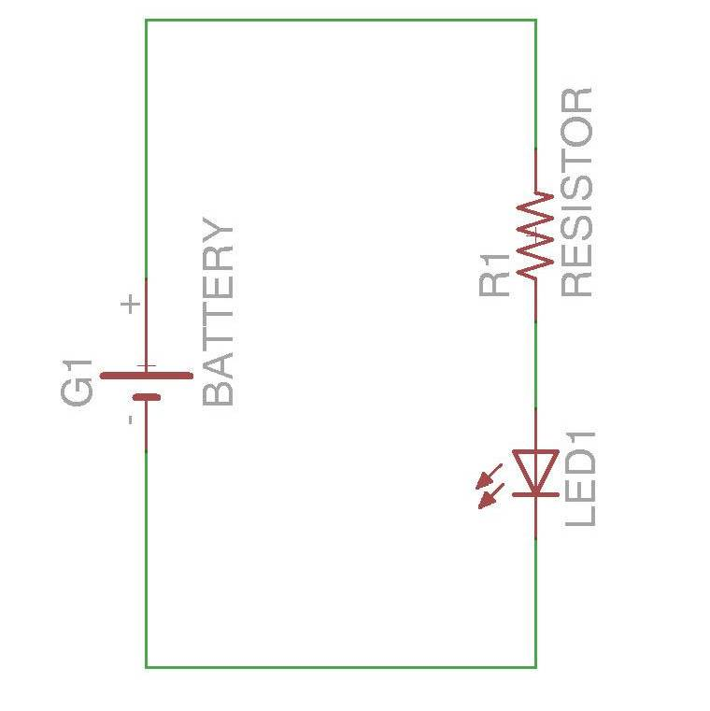
How to lit a LED?
Vs = Battery Voltage
Vl = LED forward voltage
R = Resistance
I = LED Current
R
Vs
I
Vl
LED Brightness = I = LED current. Usually 10mA ~ 30mA
Notes:
http://www.kpsec.freeuk.com/components/led.htm

Slide 9
Ohm’s Law
V = IR :
Voltage = Current x Resistance
I = V / R :
Current = Voltage / Resistance
R = V / I :
Resistance = Voltage / Current

Slide 10
How to lit a LED? = How to choose resistor value?
R = (Vs - Vl) / I
Vs = 5v
Vl = 1.5
I = 20mA(0.02A)
R = (9 – 1.5) / 0.02
= 375 ohm
R
Vs
I
Vl
Notes:
http://www.kpsec.freeuk.com/components/led.htm

Slide 11
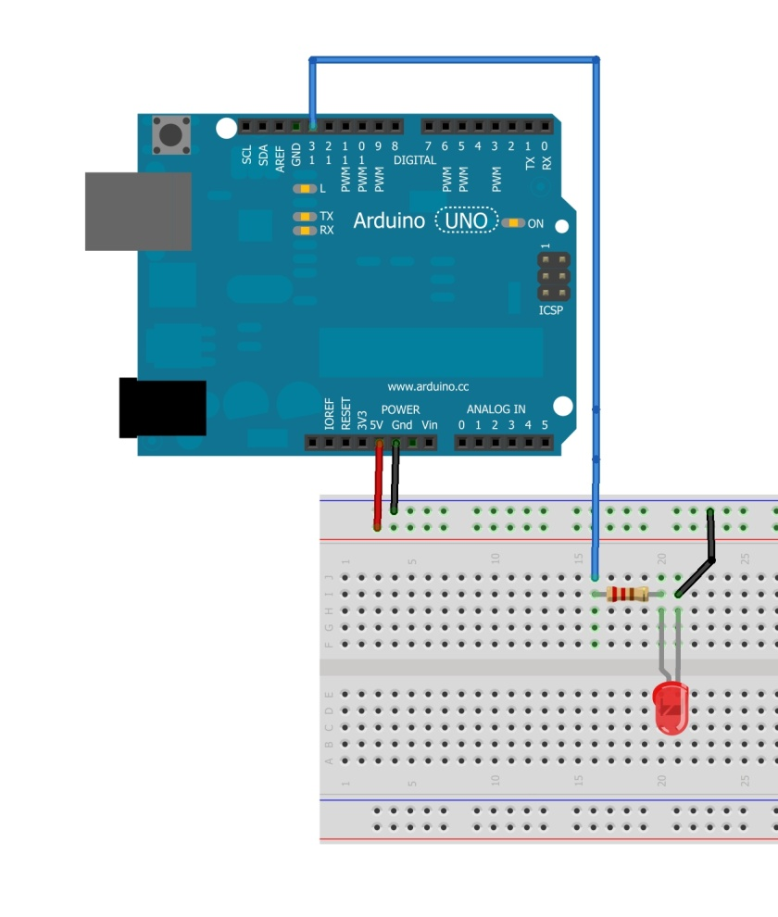
Cable Color Convention
Power Line = RED
Ground Line = Black
Signal Line = Blue
Helps you to find out
Short circuit/Power failure

Slide 12

Arduino Board(Power Signal)
0v-5v
AREF: Reference voltage for the analog inputs
1.USB Jack(to PC)
5v
GND
5v regulator: regulate
power input into 5v
7v-12v
GND
2.Power Jack(to AC adaptor)
5v
7v-12v
3. Vin(to Battery etc.)

Slide 13
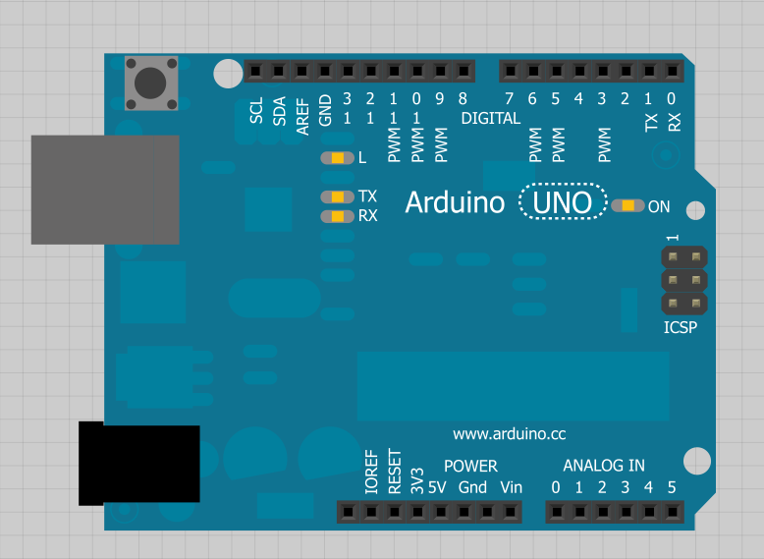
Arduino Board
Digital Input/Output
Reset Button
USB Jack
Power LED
TX+RX monitor LEDs
Power Jack
Power Pins
Analog Input

Slide 14
digitalWrite(pin,value)
5v
digitalWrite(11,HIGH);
5v
GND
5v
GND
digitalWrite(11,LOW);

Slide 15
digitalRead(pin)
2.5~5v
HIGH
5v
GND
GND(0v)~2.4v
LOW
5v
GND

Slide 16
analogWrite(pin,val),/analogRead(pin)
0~5v(PWM)
Output analog-signal(PWM):
value : 0 ~ 255
voltage: 0 ~ 5v
5v
GND
AREF: Reference voltage
Read analog-signal:
voltage : 0 ~ 5v(AREF)
value: 0 ~ 1023
5v
GND
0~5v(AREF)

Slide 17
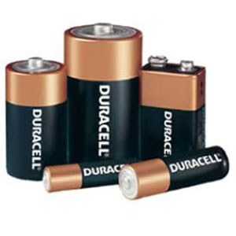
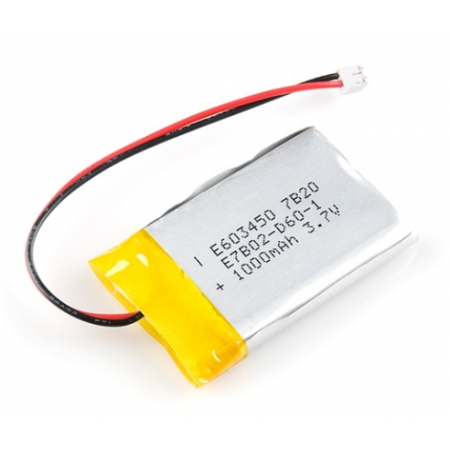
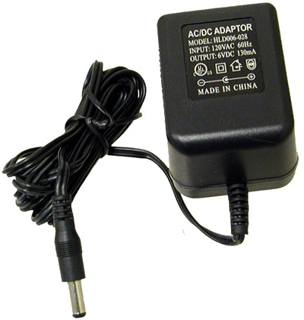
Power Sources
dry-cell battery Li-poly battery ACAdaptor
(1.2 ~ 1.5v) (3v ~ 3.7v) (5v ~ 24v)

Slide 18
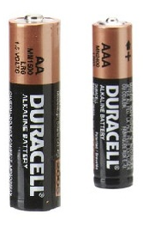
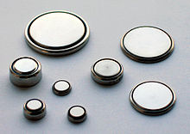
Battery Types
Lithium cells
3v
30-1000mAh
Lithium-polymer
3v~3.7
30-3000mAh
Round
1.2v-1.5v
600-2800mAh

Slide 19
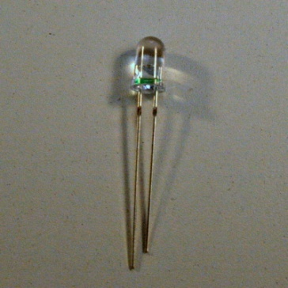
Battery Capacity
+ = = 5hr
1000mAh
20mA
Lithium cell battery
1000mAh
LED at 20mA

Slide 20
Electrical Signals
5v = HIGH
0v = LOW
Analog
Digital Signal
TTL(5v)/LVTTL3.3
AC Power Signal (245v 50hz)

Slide 21
Quick Overview:Week03
Introduction to Sensor/Actuator Modules
3-1 Sensor modules (1hr)
Touch Sensor/ Sound Sensor/Pressure Sensor/
3-2 Actuators and Basic Mechatronics (1hr)
DC motor/Servo motor/Stepper motor/Solenoid
Lever/Pulley/Gear
Circuit Bending Exercise (2hr)

Slide 22
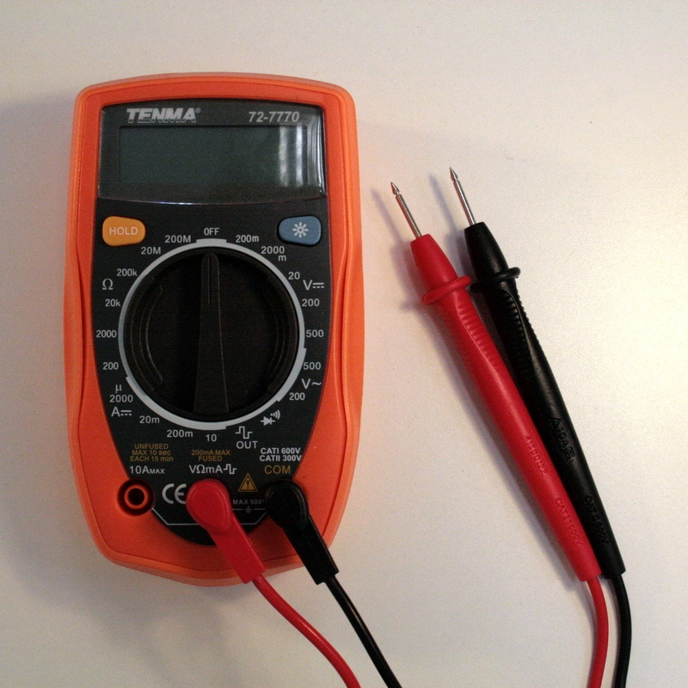
Multimeter
Resistance (Ω)
DC Voltage (V)
AC Voltage (V)
DC Current (A)
Continuity Test
Diode Test

Slide 23
Multimeter
Prove
Hold Button
(GND)
(+)
DC Voltage (V)
Resistance (Ω)
AC Voltage (V)
DC Current Test
Continuity Test
Diode Test

Slide 24
3-1 Sensor modules (1hr)
Light Sensor
Touch sensor
Sound sensor
Pressure Sensor

Slide 25
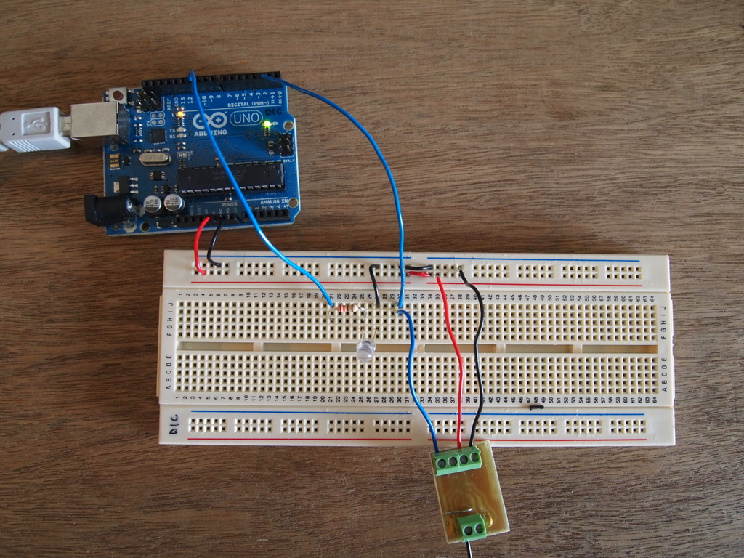
Touch Sensor/

Slide 26
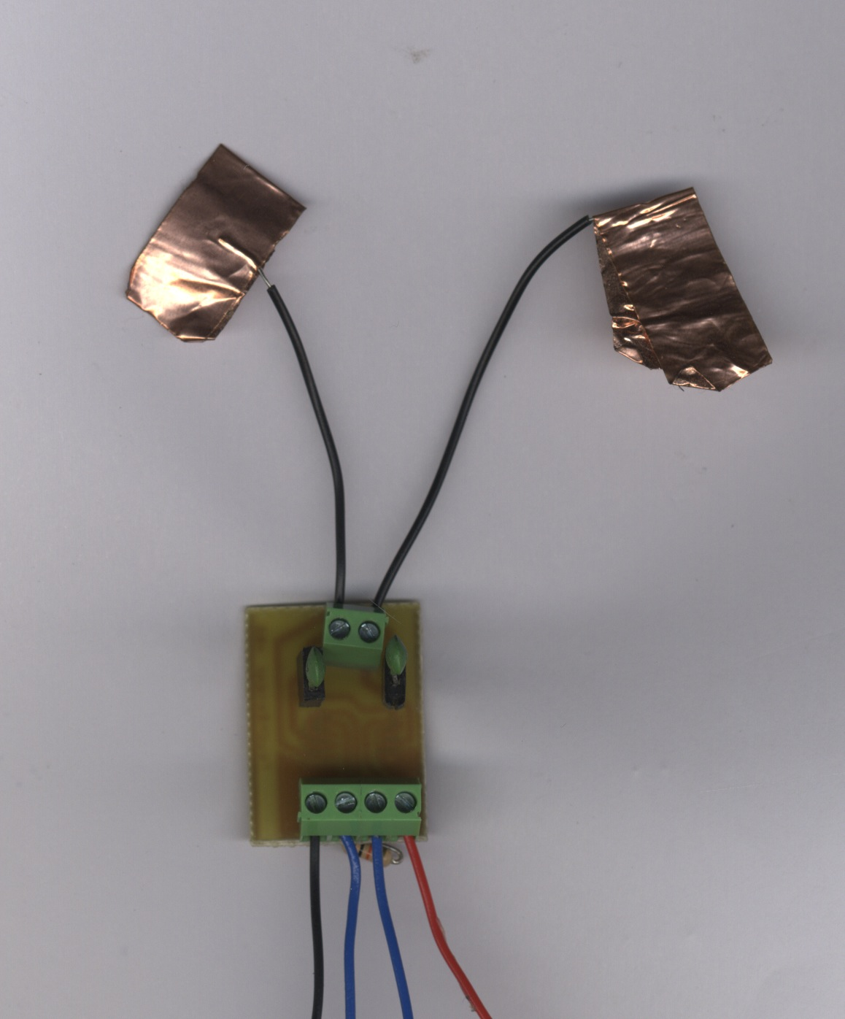
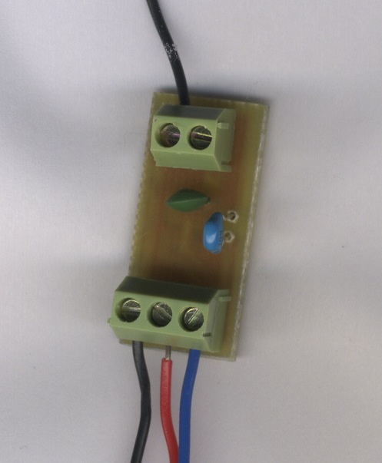
Touch Sensor
2ch Touch Sensor Module
1ch Touch Sensor Module
Pad1 Pad2
Pad1
G O1 O2 5v
G 5v O1
GND
5V
DPin2
GND
5V
DPin2

Slide 27
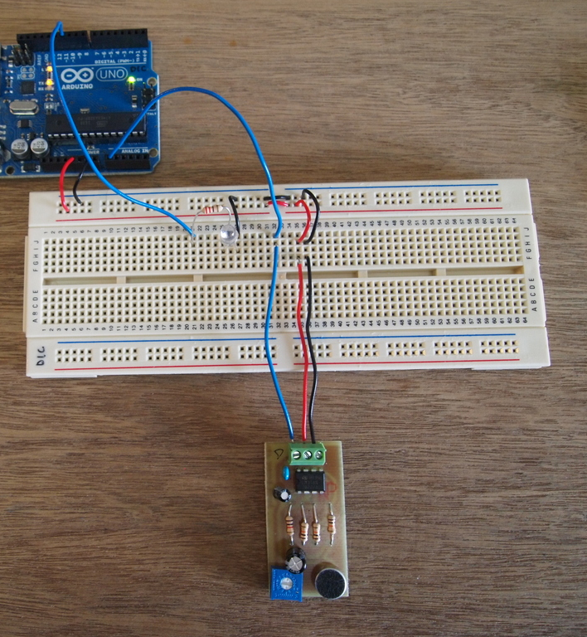
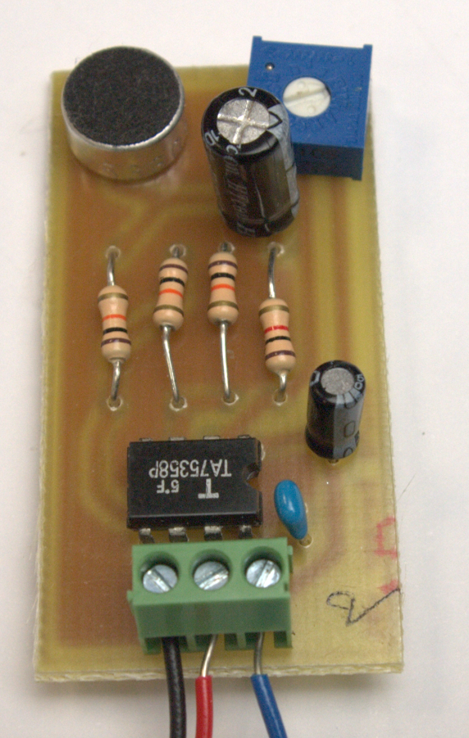
Sound Sensor/
microphone
mic gain
GND
5V
A0

Slide 28
SoundSensor/ microphone amplifier
5v
1v

Slide 29
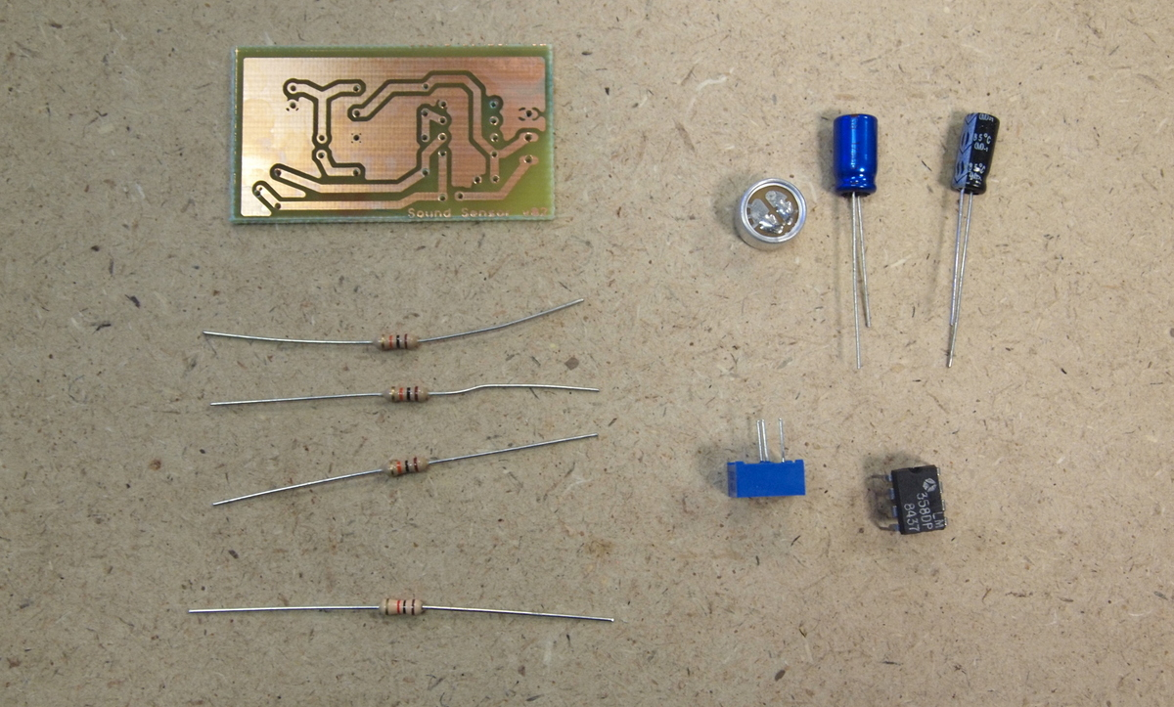
Sound Sensor Components List
Capacitor
220uF
10uF
PCB board
mic
10K
Resistors
Potentiometer (100k)
OpAmp (lm358)
1K

Slide 30
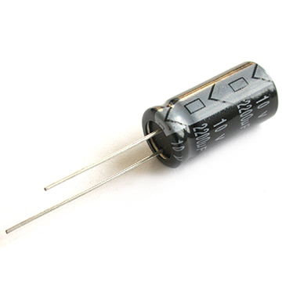
Sound Sensor ASSY
mic
100k VR
Order of Soldering
(shorter profile first)
Resistors(10kΩ x3 1kΩ x1)
LM358
0.1uF Capacitor
mic and 100kVR
220uF & 10uF
3pin Connector
+ -
220uF Cap
10kΩ
1kΩ
+ -
－
10uF Cap
LM358
0.1uF Cap
－ ＋

Slide 31
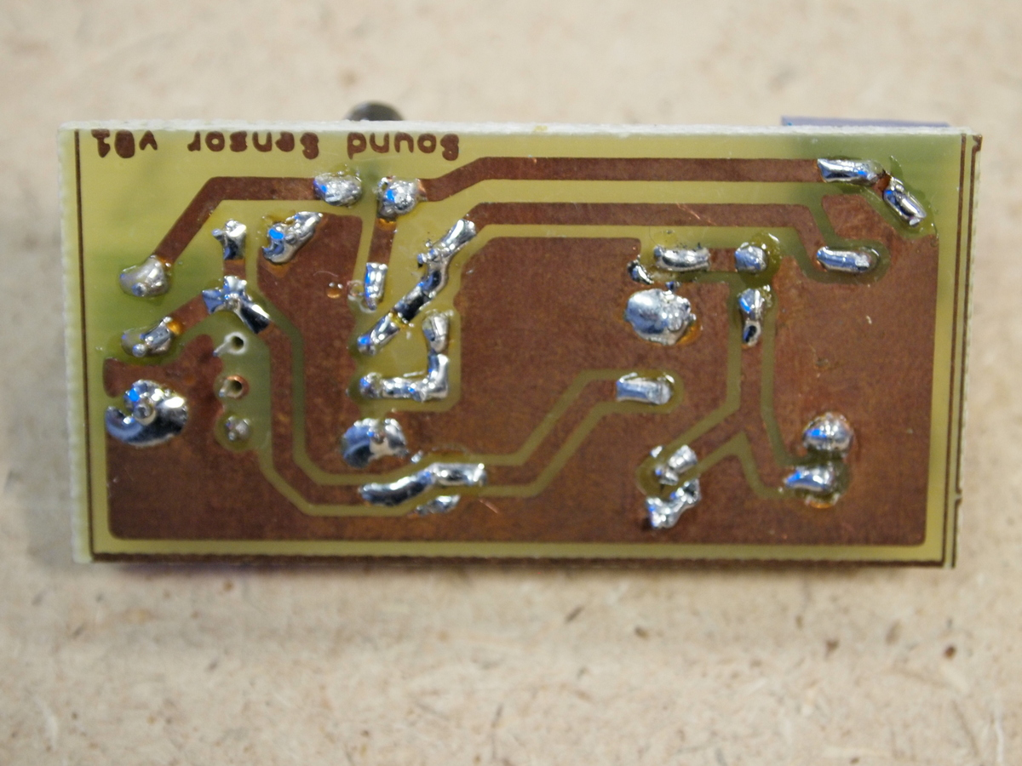
Do Check All connections before plug into Arduino

Slide 32
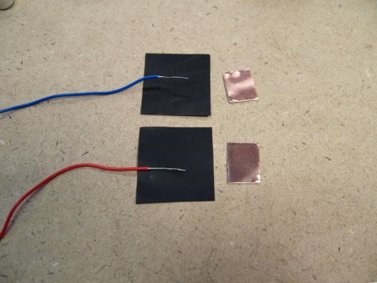
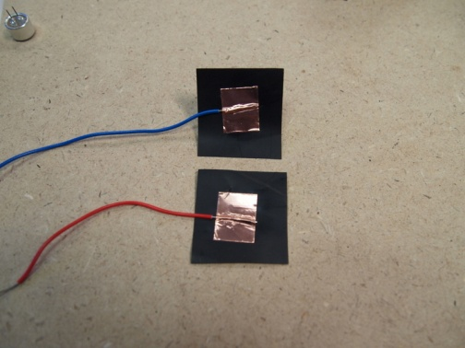
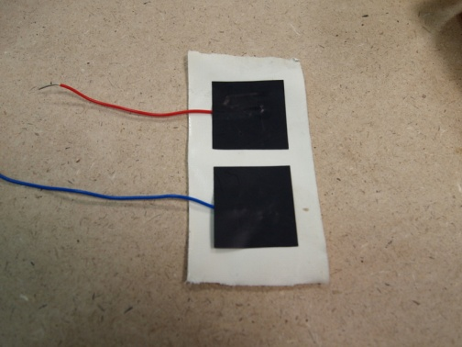
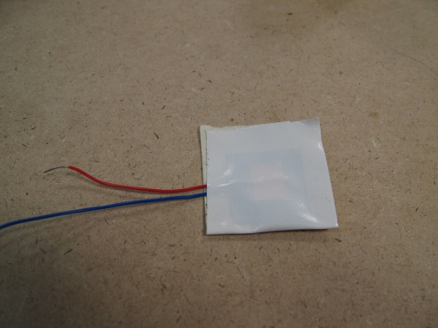
Making a Pressure Sensor
Stickytape Bend Sensor in less than 4 minutes http://www.youtube.com/watch?feature=player_embedded&v=FEPgLbPv6NM
Material: 1. Conductive PlasticBag 2. Copper Tape

Slide 33
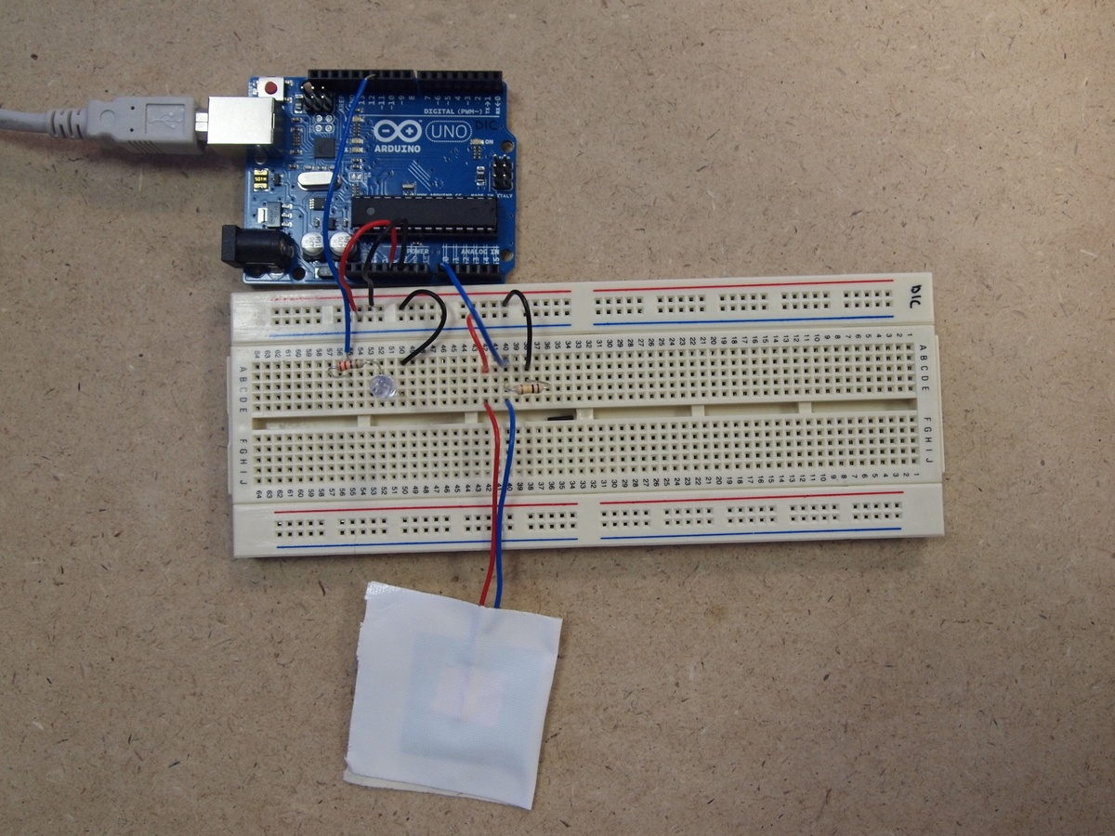
Pressure Sensor Circuit

Slide 34
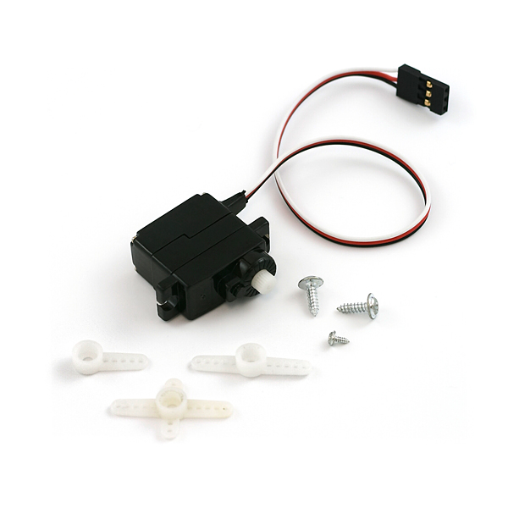
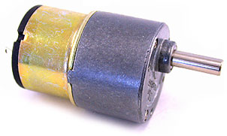
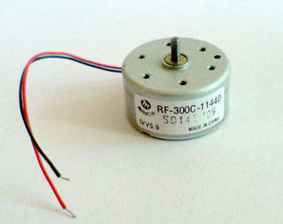
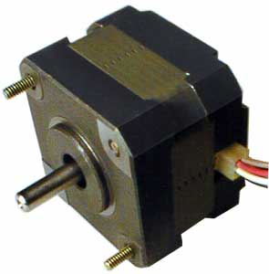
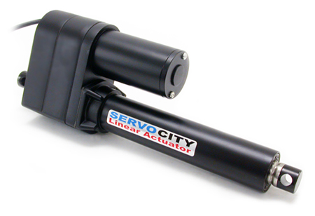
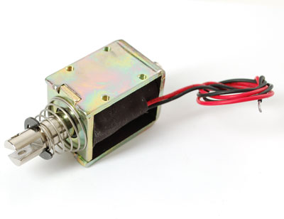
List of Actuators
Servo
DC Motor
DC Geared Motor
Linear Servo
Solenoid
Stepper Motor
Notes:
Servo
Linear Servo
DC Motor
DC Geared Motor
Solenoid
Stepper Motor

Slide 35
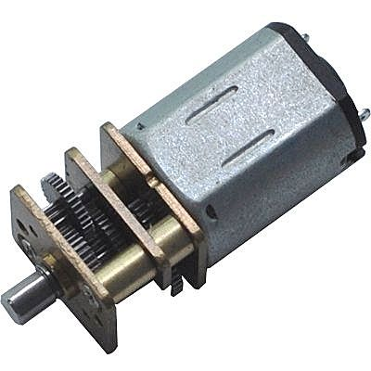
DC Geared motor

Slide 36
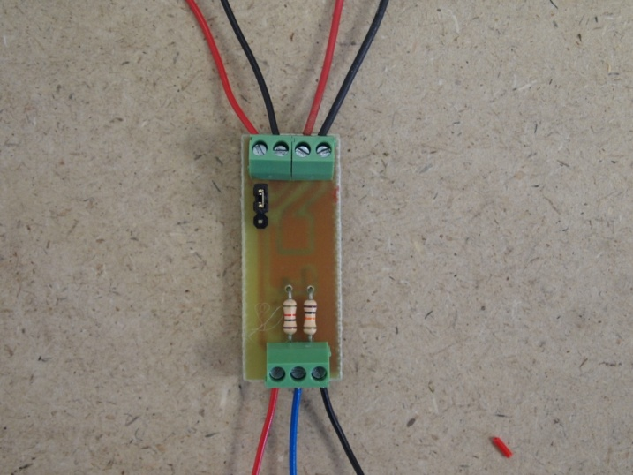
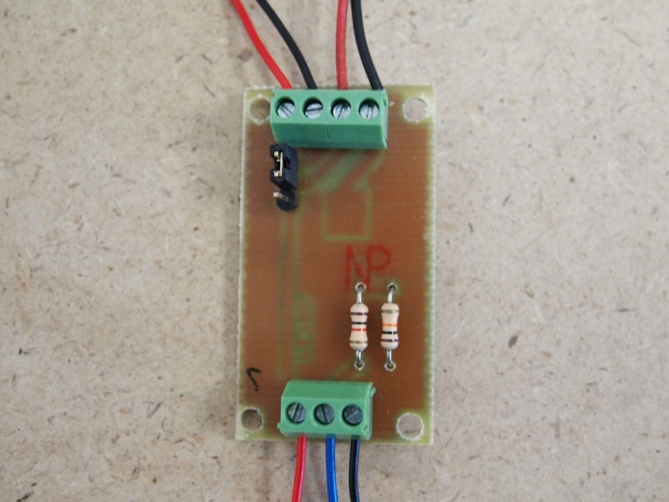
FET module
Ext power 0v-24v
ExtGND
Out+
Out-
Ext power 0v-24v
ExtGND
Out+
Out-
+5v
CTL
GND
+5v
CTL
GND

Slide 37
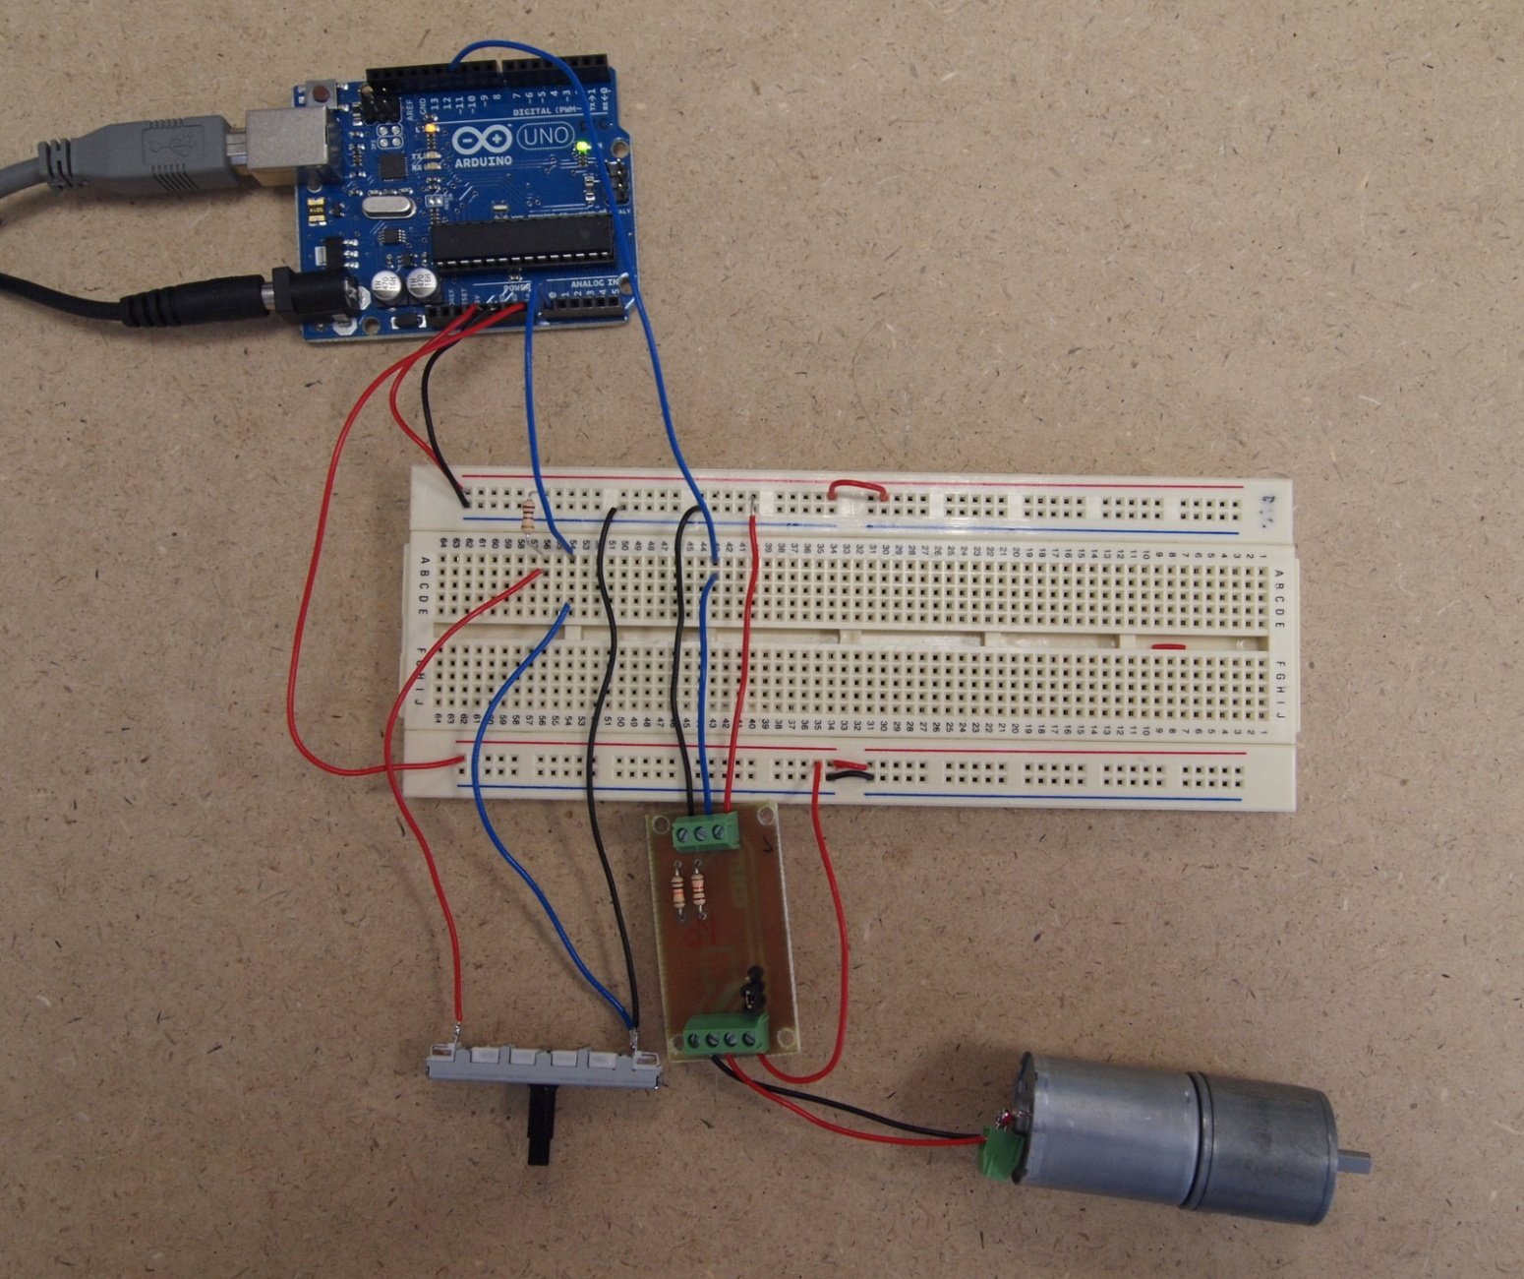
DC Geared Motor Control (FET driver)

Slide 38
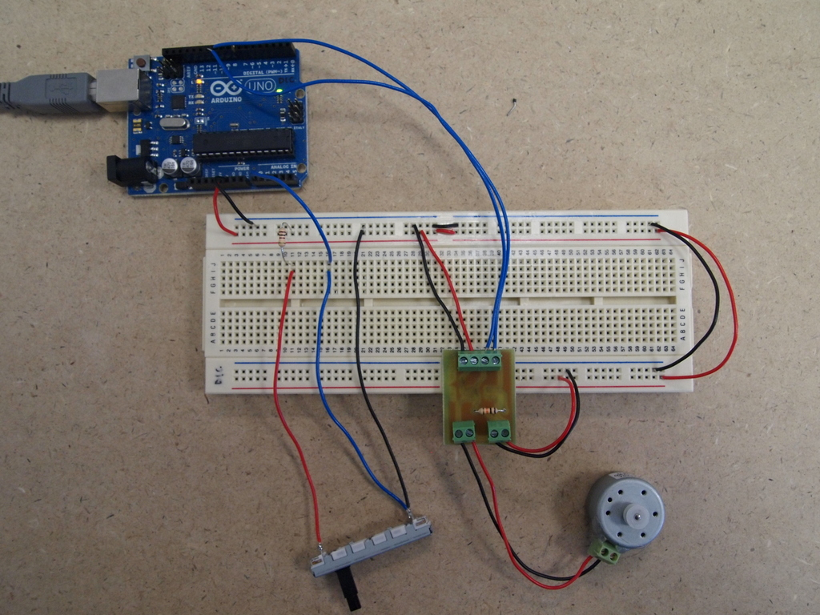
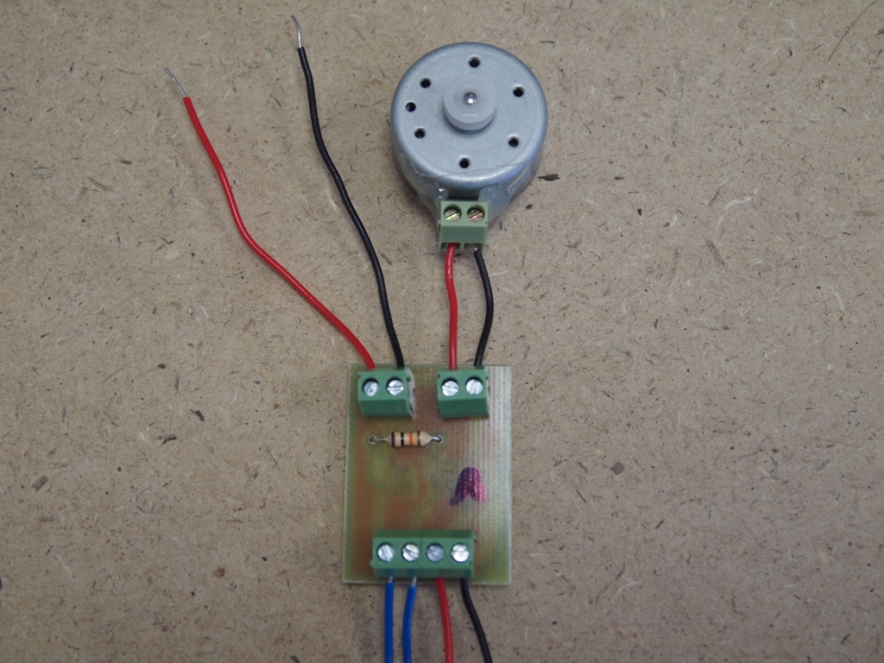
DC Motor Control (H-Bridge driver)
Ext power 0v-7v
Ext GND
FWD
RWD
+5v
GND

Slide 39
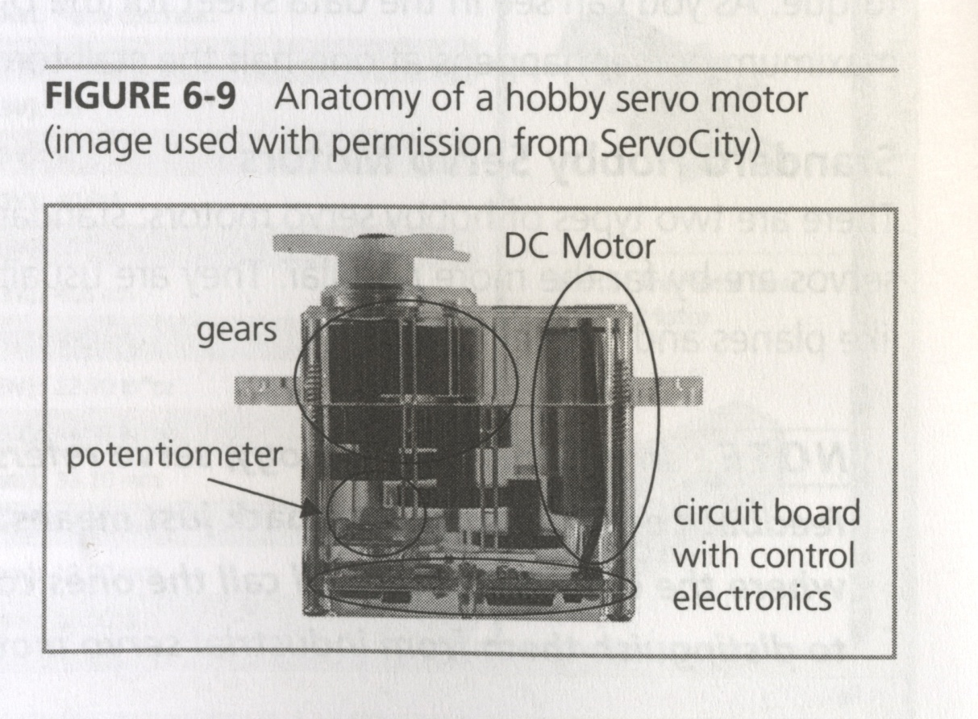
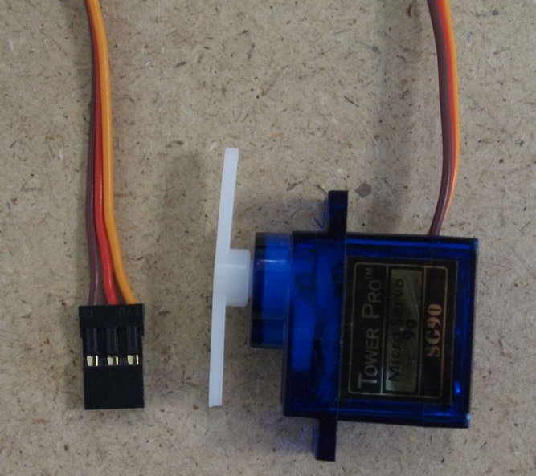
Servo Motor (Geared motor + angle sensor)
GND
5V
CTRL
Make Things Move

Slide 40
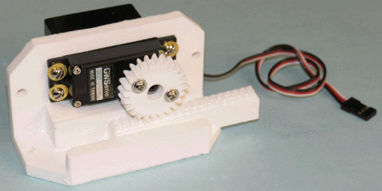
Linear Servo
http://www.youtube.com/watch?v=fq5u7jFQFCg&feature=relmfu

Slide 41
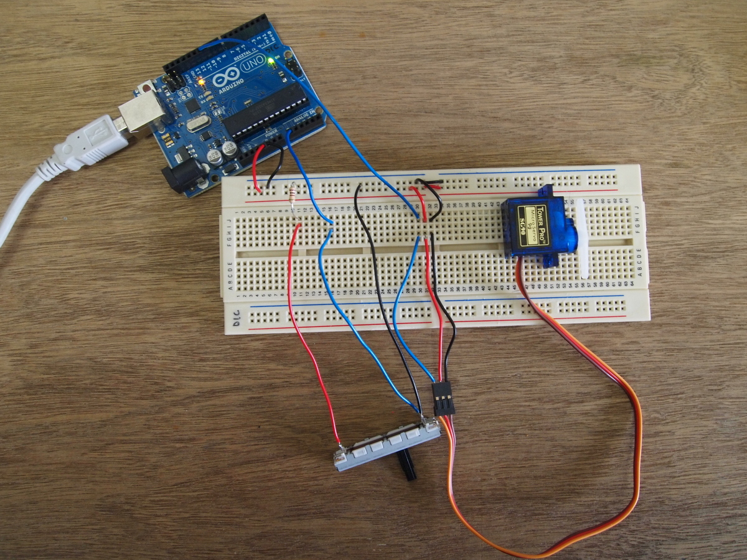

Servo Control
GND
5V
D11

Slide 42
What do we do with Sensors/Actuators?
http://www.youtube.com/watch?v=DIGTD1WGFdM
Transform Energy
Transfer Energy
Multiply / Change direction of force
Multply Speed

Slide 43

Making Things Move Dustin Roberts
http://www.makingthingsmove.com/

Slide 44
Basic Mechatronics
Lever
Pulleys
Gears
Wheel

Slide 45
Lever
Input
output
Fulcrum

Slide 46
Output = Di/Do
Di Do
1
1
1 : 1
2
1
2/3 : 1/3

Slide 47
Pulley:
Di Do
Speed = Di /Do
Torque = Do / Di
Rotate Same the Direction

Slide 48
Gear
Di Do
Speed = Di /Do
Torque = Do / Di
Rotate Opposite Directions

Slide 49
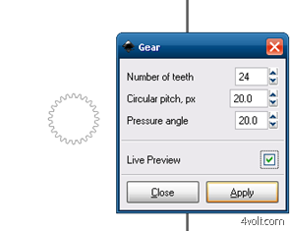

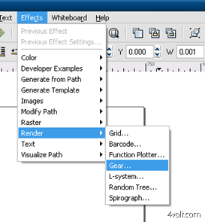
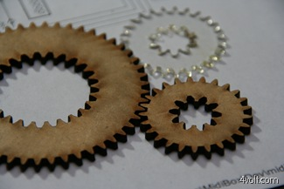
Making Laser Cut Gears with InkScape Tutorial
http://4volt.com/Blog/archive/2009/01/05/laser-cut-gears-and-inkscape.aspx

Slide 50
Assignment1: Rolling Ball machine
Design a rolling ball machine
Size within w:42cm h: 30cm d:30cm (A4 paper)
A mechanism to lift up balls
Minimum 3 Gimmicks using switches or sensors http://www.oobject.com/category/15-videos-of-amazing-rolling-ball-machines/

Slide 51
List of Shops for materials/components.
Sim-lim tower
B1 Continental Electronic
4F Kaichin/SunLight
Sgbotic:
www.sgbotic.com
Sparkfun products
http://www.sparkfun.com/
Element14
http://sg.element14.com/
RS-components
http://singapore.rs-online.com
RotorHobby
http://rotor.com.sg/
McMasterCarr
http://www.mcmaster.com/#
ServoCity
http://www.servocity.com

